Slide 1
Accident Prediction Models for Illinois Roadway Network
CS 498: DSG - Graduate Project Presentation
Jacob Mathew (jmathew7)
Trisha Das (trishad2)
Jinsong Cui (jinsong4)

Slide 2
Introduction
Motivation:
Each year in Illinois, there are around 144,000 accidents and 7000 (~5%) people lose their lives
Typically locations with high number of accidents have a systemic cause for their high numbers
Having the ability to predict the number of accidents and identify locations likely to have a high accident count can enable prioritization of locations for safety improvements.
Goal:
Develop a prediction model to estimate the likelihood of crashes as a function of the features of a location using historical crash data

Slide 3
Data
Obtained real data from Highway Safety Information System (HSISinfo.org)
Data obtained for years 2006-2010 (5 years)
Accident data (contains information about characteristics of accident)
Roadway data (contains information about characteristics of roadway)
Vehicle data (used to remove pedestrian accidents from analysis)
Before start of analysis the data was:
Merged so that each accident is corresponding to a segment of the road.
Filtered data to have a meaningful dataset
Missing values were imputed (speed limit)
Based on background knowledge, categorical features with high number of categories were reduced

Slide 4
Data Filtering
To filter data:
Remove pedestrian accidents
Remove locations where number of lanes were marked as 0
Remove locations with traffic volume (aadt) = 0
Remove locations where lane width (lanewid) < 10 feet
The standard is 12 feet, but removing locations with lanewid < 12 feet removes 35000 accidents
Removing locations with lanewid < 10 removes only 1700 accidents

Slide 5
Improving Features
Curve Radius (curv_rad): Gives the radius of curve in feet
Changed to binary categorical variable
If curv_rad = 0 => straight segment
If curv_rad > 0 => curved segment
Median Type (med_type): One of the eight type of medians
Changed to binary categorical variable
No median
Median Present

Slide 6
Improving Features
3. Surface Type (surf_typ): One of the twenty five type of surface
Changed to categorical variable
Flexible surface (i.e. asphalt pavement)
Rigid surface (i.e. concrete pavement)
Others

Slide 7
Imputing missing values
Speed limit: Posted roadway speed limit
There were 105,209 (12.7%) missing values
Speed limit was available in multiples of 5, and we divided it into 11 classes
The missing values were imputed based on multi-class classification Random Forest model.
Accuracy of speed limit model is 87% on test data

Slide 8
Features used for prediction
Number of lanes
Lane width
Curve?
Length of Segment
Access control at the location
One way?
Median?
Speed Limit
Surface Type
Rural or Urban
Roadway classification

Slide 9
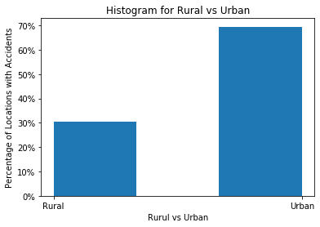
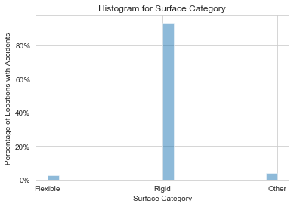
Data Distribution

Slide 10
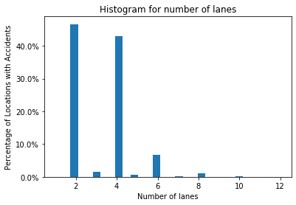
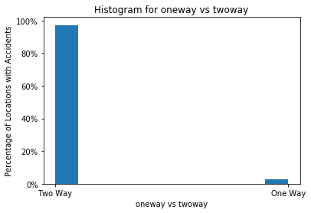
Data Distribution

Slide 11
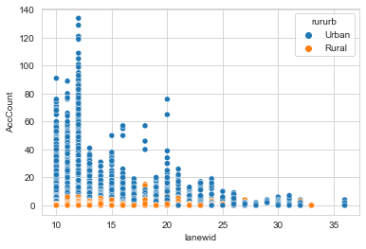
Lane-width vs Accident Count

Slide 12
EDA Summary
Identify the continuous variables and discrete variables and apply proper data cleaning techniques.
Identify the correlation between each column variable and visually inspect outliers by pair plot
Hypothesis:
The accident count is a variable (observation) based on many variables in the dataset like road types and conditions (hidden state) but not all variables.
The accidents didn’t happen at the same time, so can be treated as a sequenced data.

Slide 13
Methods
Accident count is positive integer
Preliminary analysis used a binary classification model
On further analysis we classified locations with accidents as
Zero accident location
Low accident location (1 - 30 accidents)
Medium accident location (31- 50 accidents)
High accident location (> 50 accidents)

Slide 14
Models Used
Classification Model
Logistic Regression
XGBoost
Neural Networks
“Hidden Markov Model”
Used to predict the sequence of occurrence of accidents.

Slide 15
Classification Model Pipeline
Train data: 827246 data points
Test data: 2000 data points
Data normalized using standard scalar
Models validated using k-fold cross validation

Slide 16
Motivation for HMM
We have data available as a sequence.
A location which witnessed high number of accidents could experience a reduction in the number of accidents in the following year as location may be improved or vice versa
We assumed two states that the system could be in
High likelihood of accident
Low likelihood of accident
Emissions (or observations) is the accident count observed
Divided into 4 categories: ‘Zero’, ‘Low’, ‘Medium’, ‘High’

Slide 17
Transmission and Emission Probability
As an observer,
It is difficult to say which state (high likelihood or low likelihood) a location is in in any particular year
Without knowing the states of the previous observations, it is difficult to estimate the emission probabilities
Therefore
We reduced the problem to one ‘hidden state’
With four possible values for the observations as previously listed

Slide 18
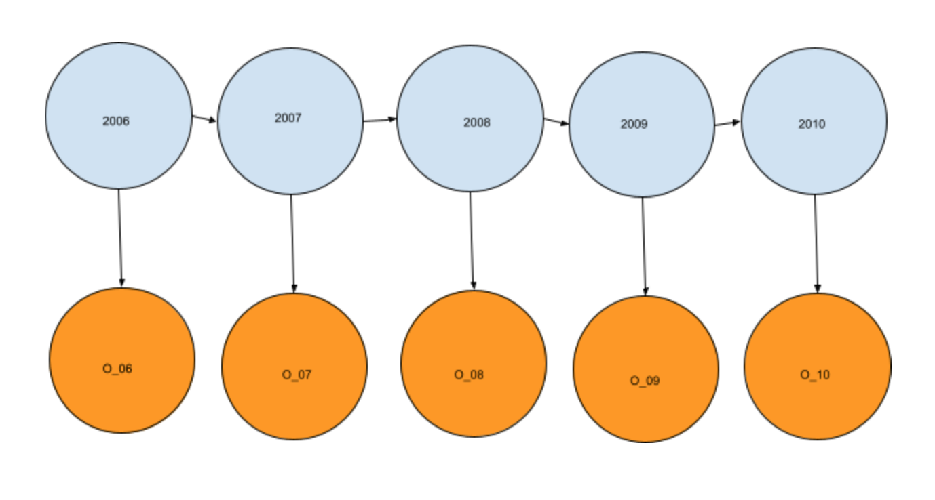
O_i = Observation for year i
P(O_10|O_06, O_07, O_08, O_09) = ?

Slide 19
‘HMM’ cont.
Using data for the years 2006-2009, we estimated emission probabilities
Used multi-class logistic regression to estimate emission probabilities
Emission probabilities depend on the characteristics of the location
Test dataset is the data for the year 2010, which had corresponding values in the previous 4 years.

Slide 20
Discussion of Results
The models developed were compared based on the accuracy metric
Model | Accuracy
Logistic Regression | 68.6%
XGBoost | 69.85%
Neural Networks | 73.60%
“Hidden Markov Model” | 79.15%

Slide 21
Conclusions and Recommendations
The study developed a predictive model to estimate the likelihood of crashes on highway network in Illinois using real world data
Accident count is positive integer value. This was modified into categories to use classification algorithms to build predictive models
Missing values in data was imputed
Data cleaned and filtered and modified before analysis
Based on study, the Hidden Markov Model gives the best predictive accuracy and therefore is recommended.

Slide 22
Limitations and Future Work
Limitations in data:
The available data for the years 2009 and 2010 are reduced due to higher restrictions
Classification models doesn’t consider accident history of a location while making prediction
The transmission probabilities in the HMM might change if the characteristics of a location changes. This is not considered in our study.
Future work
Model could be extended to predict the severity of a crash along with the likelihood of crash

Slide 23
Thank you
Questions/ Comments/ Feedback?
Jacob Mathew(jmathew7)
Trisha Das(trishad2)
Jinsong Cui(jinsong4)

